Slide 1



1.a Operating Systems
Operating System Definition and Brief History

Slide 2

An Operating System (OS) is a software that acts as an interface between computer hardware components and the user. Every computer system must have at least one operating system to run other programs. Applications like Browsers, MS Office, Notepad Games, etc., need some environment to run and perform its tasks.

Slide 3


Operating Systems
User
Applications
Operating System
Hardware

Slide 4
OS Functions
Convenience
Efficiency
Ability to Evolve
Throughput

Slide 5
Functionalities of OS
Resource Management
Process Management
Storage Management
Memory Management
Security/Privacy Management

Slide 6
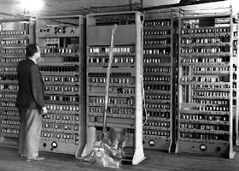
History
1940–1956: First Generation
— Vacuum Tubes
the first electronic computer was developed in 1940, it was created without any operating system

Slide 7
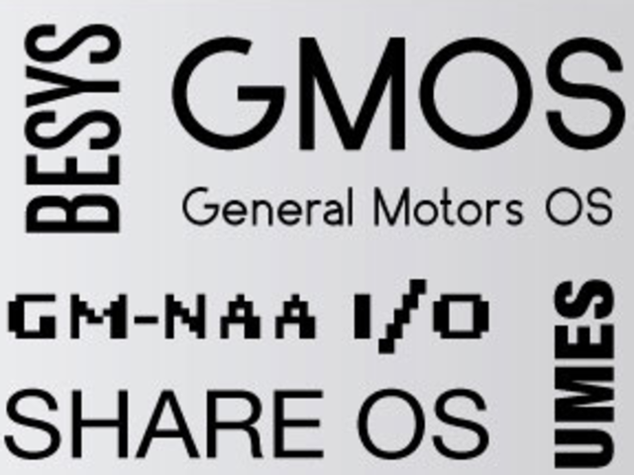
History
The Second Generation (1955 - 1965)
The first operating system (OS) was created in the early 1950s and was known as GMOS. General Motors has developed OS for the IBM computer

Slide 8
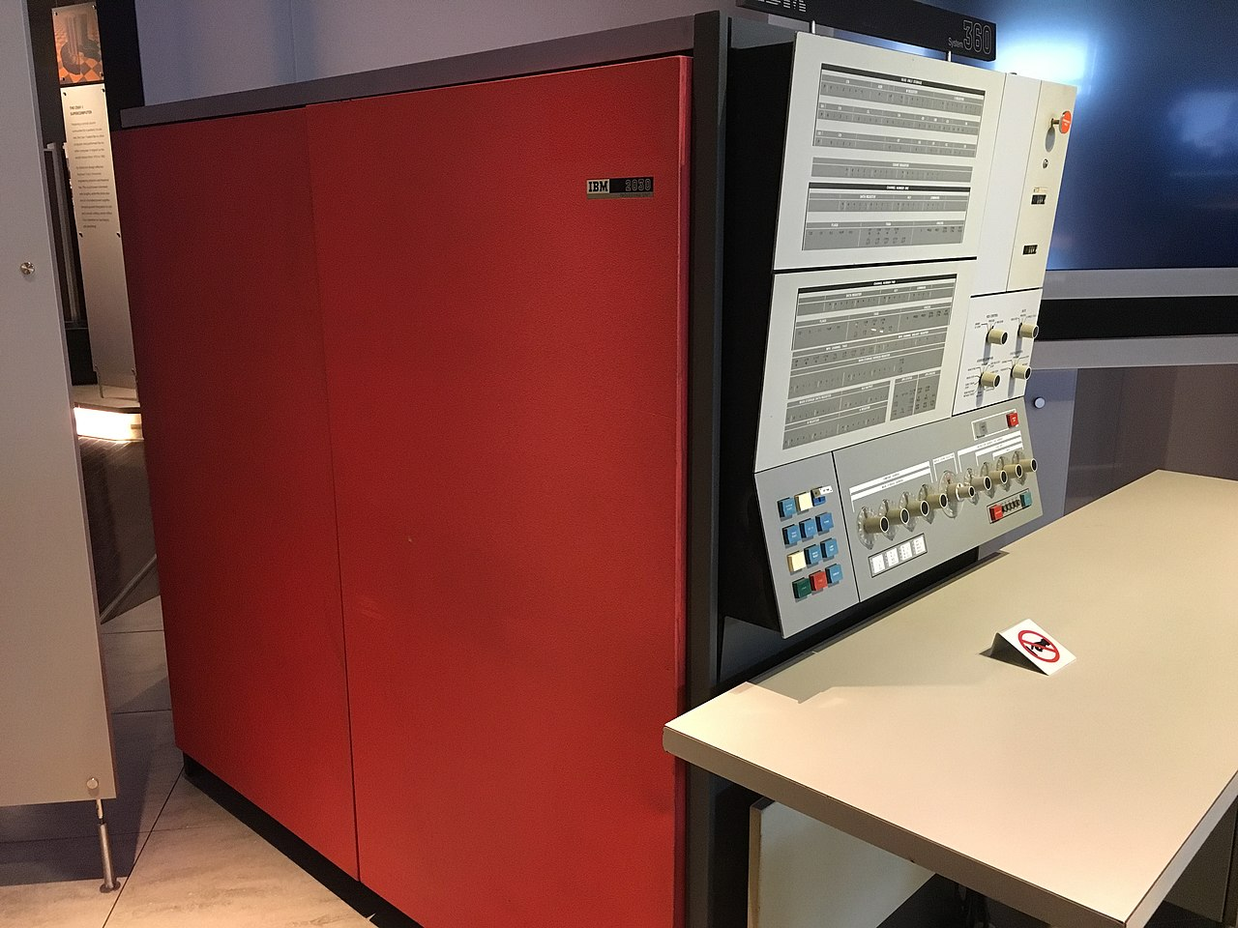
History
The Third Generation (1965 - 1980)
IBM Developed For 360/System mainframes.
The Unix operating system was developed at AT&T Bell Laboratories in the late 1960s, originally for the PDP-7,

Slide 9
History
The Fourth Generation (1980 - Present Day)
MacOs, Windows, Linux, Android, iOS

Slide 10
Operating Systems
User
Applications
Shell
Kernel
Boot loader
HW

